Slide 1
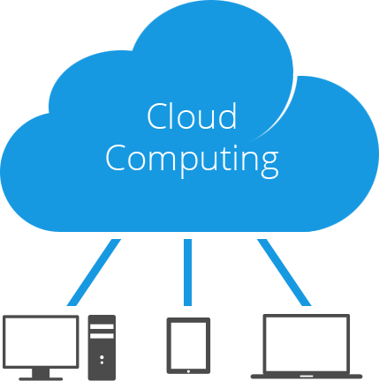

CATHOLIC UNIVERSITY IN ERBIL
College of Information Technology and Computer Sciences
Department of IT
WELCOME TO
Cloud Computing
Third Stage – Second Semester 2023-2024
Lecture#7: Capacity Planning in the Cloud
Assistant Lecturer : Ahmed Abdulfatah
IT35
Ahmed.abdulfatah@cue.edu.krd

Slide 2
Previous Lecture
Scaling in Cloud
What is Scaling?
Foundation of Cloud Scaling
Scaling Strategies in Cloud
Scaling Types
Performance and Scalability

Slide 3
This Lecture
Capacity Planning in Cloud
What is Capacity Planning?
Capacity Planning in Cloud Computing
Approaches for Capacity Planning
Capacity and Approaches
Steps for Capacity Planning

Slide 4
Learning Outcomes:
Learners should comprehend the principles and concepts of capacity management, including forecasting, monitoring, analysis, and optimization techniques relevant to cloud environments.
Understanding the concepts of scalability and elasticity in cloud computing and how they impact capacity planning decisions, including the ability to scale resources up or down dynamically based on workload fluctuations.
Students should be able to model workloads, predict future resource requirements, and perform capacity planning based on workload forecasts and growth projections.

Slide 5
1-WHAT IS Capacity Planning?
Capacity Planning in computing is a process that determines the future requirement of computing resources to provide desired levels of service to a given workload at the least cost.
The goal of capacity planning is to identify the right amount of resource requirement to meet the service demands at present and also in the future.
A cost effective agile system can only be developed by understanding these shifting resource needs, and with proper capacity planning in place.
Every application is different and every user behaves in a different way.
Capacity planning is required to overcome this unpredictability, and determine what volume of hardware resources are required to meet the application needs of users adequately so that they never feel a resource crunch.
In a networked environment like cloud computing system, capacity planning is important both for computing as well as networking resources.

Slide 6
2-CAPACITY PLANNING IN COMPUTING
Capacity planning is essential for any resource to balance supply and demand, so that a system does not run into crisis. As the computing resource management ideas have changed with time from in-house to outsourced and then to cloud, so has capacity planning.
Traditionally, capacity planning in computing has been performed in silos (isolated storages or data centers to stock resources) or in isolated organizational structures. The other problem was that the actual stakeholders had very little control over the capacity planning process. Hence possibilities of gaps between real capacity and the actual demand were high. Also, the fixed resource capacity within a silo makes it difficult to manage varying resource needs of an application over time. In such a scenario, both over-provisioning and under-provisioning of resource ultimately turns expensive from the business point of view.
The solution to this problem only appeared with the removal of small silos and the creation of scope for the end users to regularly take part in capacity planning process. The cloud model of computing has created this scope, where end users can self-provision the resources without interacting with the provider. This increases efficiency and reduces wastage of resource.
In traditional computing, end users had little participation in the capacity planning process.

Slide 7
3-CAPACITY PLANNING IN CLOUD COMPUTING
Cloud Computing as a utility service promotes multi-tenancy and resource sharing. This removes the requirement of creating small silos of computing infrastructures.
A large number of consumers are served by a reputed cloud service provider through various services, and each consumer has access to a great volume of resources which are limitless as compared to their individual computing resource requirements. This may raise doubts regarding the need of capacity planning in cloud computing.
Why perform the complex task of capacity planning when cloud can supply limitless volume of resources? Is it not an unnecessary thing to do? Unfortunately, this perception is not accurate, and if not taken seriously can pose serious problems and can even derail the effectiveness of the whole computing strategy.
The reality is actually different from this common perception of limitless availability of resources to individual consumers.
Resources are never limitless in cloud and capacity planning is just as important in cloud computing as it was in traditional computing.

Slide 8
Infinite Resource: An Illusion, Not Reality
In reality, cloud environment gives the illusion of infinite computing resources available on-demand.
The creation of this illusion about infinite resources marks the difference between success and failure for a service provider.
The delivery model of resources in cloud computing can indeed provide what may seem to appear to be an infinite supply of resources on-demand, but it comes at a cost, and that is why we need proper capacity planning.
The illusion of infinite computing resources is possible with a business model where one service provider has many clients and an enormous number of applications to support their single or multiple connected data center(s).
The service provider needs to have a clear idea about the resource needs of all clients in advance, so that it can arrange enough resources to support all applications without a resource crunch at the time of high demand. This is the philosophy behind capacity planning in cloud computing.
For successful capacity planning the consumers must also provide a rough idea in advance to the service provider regarding their varying resource requirements throughout the year. This helps providers plan accordingly and reserve an adequate amount of resources for every application during high demand periods. The impression of infinite resource availability in cloud computing can only be created through proper capacity planning along with other measures.

Slide 9
Who Does the Capacity Planning in Cloud?
In cloud computing, capacity planning is done at two levels. At the first level, each consumer of a cloud service does his own capacity planning. At the second level, the cloud service provider analyzes the capacity requirements of all consumers together and makes the ultimate overall capacity planning. In this regard, cloud service consumers can be divided into two groups.
IaaS consumers generally plan and reserve a fixed capacity of resources they would consume for a period. This drives them to do their own capacity planning task, but only for the virtual resources they consume.
SaaS and PaaS consumers generally opt for a dynamically metered resource use model. Hence their declaration about service requirements noted in the service level contracts (SLA contract) is considered very important for the provider in the capacity planning process.
Cloud Computing enables consumers to pay only for what they get. However, consumers should also manage their demands so that they consume only what they plan to pay for.

Slide 10
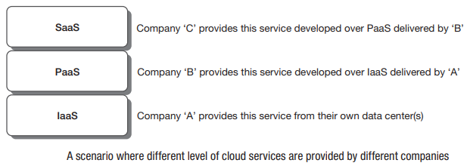
Capacity Planning at Different Service Levels
To explain the whole scenario in a simple form, let us consider three different companies who are providers of different cloud services under some agreement. Company ‘A’ – IaaS facility provider, company ‘B’ – PaaS facility provider, and company ‘C’ – SaaS provider. The customers of company ‘C’ are application users (end users of computing). They can take three ways to inform ‘C’ about capacity requirements. Case-1) can estimate their exact business requirement and inform ‘C’. Case-2) Pass the entire responsibility of supporting their demand to company ‘C’. Case-3) can take a middle path where business demand beyond a certain (estimated) level will be supported by ‘C’. The choice and requirements have to be mentioned as contract in SLA, so that ‘C’ can estimate capacity requirements and take appropriate measures to arrange them. Company ‘C’, after accumulating all SLAs made with its consumers has to estimate the future demands in a similar way. They also have the three similar choices like its consumers

Slide 11
Capacity Planning at Different Service Levels
Company ‘B’ has two options to maintain resource capacity to support their business demand. With proper estimation, ‘B’ can keep few additional virtual servers (supplied by ‘A’) under their hold as reserved resources, to support any unexpected raise in load to manage the capacity themselves. The other option is to directly pass the ball (the responsibility of capacity planning) to company ‘A’ keeping faith on their capability. They can take the middle path also, by managing the capacity planning up-to a certain level by themselves and then passing the responsibility to the infrastructure service provider in extreme cases. But, a reputed service provider must handle the responsibility on their own, without depending on others. The physical infrastructural resource management is the responsibility of the IaaS service provider ‘A’. They have no option to pass the capacity planning task to other service providers as providing physical resources is the ultimate responsibility of the IaaS provider ‘A’. Although SaaS and PaaS consumers can not directly participate in capacity planning activity, they should estimate business demand and inform their respective underlying layers regarding future demand in advance. Each layer must remain well aware about possible future demand to keep them-self ready. If company ‘B’ remains uninformed (from its upper layers) and fails to support resource demand beyond their planning, then it is likely that ‘A’ may fail to support the feature load in many instances, if multiple among their consumers (like ‘B’) fail to do so and. IaaS facility provider should be seen as the last line of defense, and the ball (the responsibility of supplying infinite resources) should be not be allowed to pass on there.

Slide 12
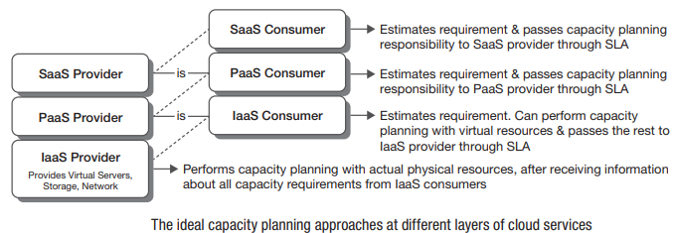
Role of Service Level Agreement
Service Level Agreement (SLA) contains the details of the contract made between the service provider and the consumer. The quality, and scope of the service must also include terms regarding the infinite resource provisioning arrangement when the SLA is about cloud computing. Both parties must understand the constraints and agree upon the limits of resource availability.
Service level agreement should address the expected and acceptable level of services.

Slide 13
4-CLOUD CAPACITY: CONSUMERS’ VIEW vs PROVIDERS’ VIEW
The cloud consumers see the cloud as an infinite source of resources that can be consumed as required. They believe that cloud can support any amount of resource demand. But, this is clearly not the actual case.
From the provider’s point of view this is a very tricky thing to handle. It is the responsibility of the cloud provider to create the impression of infinite resources. Since service provider makes estimation about future resource requirements through appropriate capacity planning and arranges for those resources, consumers get the impression that resource is infinite.
For service consumers one advantage is that, this sometimes eradicates the pains of capacity planning from their end. Detail planning can be skipped to reduce efforts and small mistakes can be corrected more easily.
For service providers, arranging any amount of resource to support capacity requirement is not a difficult task due to ever declining hardware prices. Service providers take the pain of planning for capacity management in cloud to create the illusion of infinite resource capacity for their consumers.

Slide 14
5-CAPACITY PLANNING: THEN AND NOW
In earlier days, during the traditional model of capacity planning, resource requirements used to be estimated to support a system for a relatively longer period of time with fixed cost associated with it.
But as time progressed, everyone wanted to get away with carrying the fixed costs associated with maintaining their own computing.
They rather preferred variable cost pay-peruse model.
Cloud computing has created the scope for the computing service consumers. Why should then any organization maintain a large computing infrastructure?

Slide 15
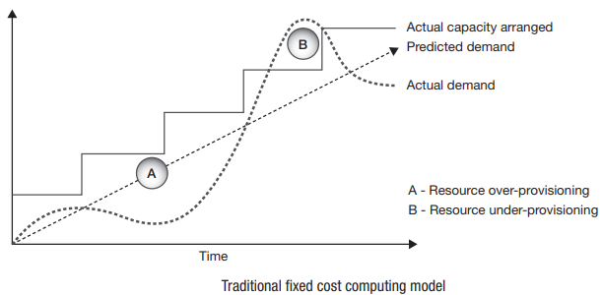
Traditional Fixed Cost Computing Model
Traditionally computing capacity planning of organizations was based on a fixed cost model. Organizations used to set up their computing infrastructure themselves or outsource it, but the investment for computing resources was fixed. In that approach, there were possibilities of occurrence of two different problematic scenarios. First one due to over-provisioning, and the second due to under-provisioning of resources
Traditional fixed cost capacity model suffers from the problem of over-provisioning and under provisioning of resources. Both of these are costly for any business

Slide 16
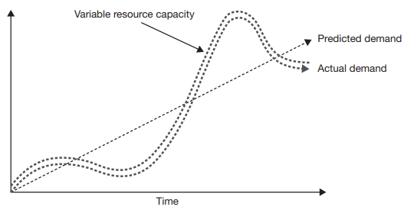
Modern Variable Cost Computing Model
Consumers under this model rarely acquire any unnecessary volume of permanent computing resources, and use resources on rent. They pay the service provider on use basis. This comes as the biggest opportunity for computing service consumers today to reduce their total expenses, as they can easily move towards the variable cost operating model.
The variable cost operating model can closely match the resource capacity with actual demand and it thus decreases cost of computing by reducing resource wastage.

Slide 17
6-APPROACHES FOR MAINTAINING SUFFICIENT CAPACITY
Traditional Approach with N+1 Rule
Dynamic resource provisioning to meet application demand is not immediate, as deploying and booting up a new compute node takes some time. If a smooth experience for the user is important, then rules that respond early enough have to be followed, so that the capacity remains available at the time of demand. Moreover, a system is always built on the assumption that node failures will happen in future, and by taking proactive measures to ensure that failures do not result in application downtime. The primary proactive measure is also taken by ensuring sufficient capacity. Traditional resource capacity maintenance strategies are commonly referred to as N + 1 rule, where N + 1 nodes are deployed even though only N nodes are really needed to support the current requests or application demands, and ‘+1’ is the additional capacity added in case demand exceeds supply of ‘N. So, in case one node fails or gets interrupted, that won’t have any impact to the application. This ‘+1’ node provides a buffer in case of a sudden spike in activity, and also provides extra insurance in the event of an unexpected hardware failure of a node. Without this buffer, there is the risk that incoming requests can overburden the remaining nodes, reducing their performance, and even resulting in user requests that time out or fail.
Traditional capacity planning approach suggests maintaining one additional resource node than actually required to save the system during crisis.

Slide 18
6-APPROACHES FOR MAINTAINING SUFFICIENT CAPACITY
2-Cloud Specific Approach
The traditional approach has obvious limitations. Depending on the business requirements, the N+1 rule may not always be sufficient.
Cloud infrastructure service with virtual resources offer a more flexible and scalable approach, where auto-scaling mechanism always maintains sufficient resource capacity for applications to serve legitimate loads.
Auto-scaling relieves the capacity planners who are cloud service consumers from the wearisome job of monitoring and maintaining sufficient capacity, and the system manages capacity itself.
Cloud infrastructure service providers (IaaS providers) build up the service with actual physical resources and hence cannot go beyond the traditional approach of capacity maintenance. But the way cloud service consumers approach capacity planning, has seen a total shift.

Slide 19
7-ROLE OF AUTO-SCALING IN CAPACITY PLANNING
One of the most useful features of cloud infrastructures is the ability to automatically scale a resource with little or no impact on the applications running in that infrastructure. This is possible for the resource sharing and multi-tenancy capability of cloud computing model.
Resources not being used by some application are released to be added to the resource pool, from where other applications get their necessary resources.
The traditional (non-cloud) approach was to maintain infrastructure keeping the peak capacity of each application in the mind and wasting resources, as most part of the resources would remain unutilized for most of the time.
The shortcoming of automatic cloud scaling is that the lazy application designers can use this attribute as an opportunity to avoid the critical process of capacity planning.

Slide 20
8-CAPACITY AND PERFORMANCE: TWO IMPORTANT SYSTEM ATTRIBUTES
Many people equate capacity planning with system performance, but this is not correct. Performance enhancement of any system is performed through system optimization or performance tuning.
Appropriate capacity planning undoubtedly improves system performance, but the main objective of capacity planning is to meet the future demand of workloads on a system by arranging the additional system capacity (resources) in a feasible manner.
Capacity planning measures the maximum amount of work that can be done using the current resources and then arranges resources to do more work as needed. If system optimization is done during capacity planning phase, it is good, but capacity planning efforts focus on meeting demands. With capacity, the concern is about how much work a system can do, whereas with performance, the concern is the rate at which work gets done.

Slide 21
9-STEPS FOR CAPACITY PLANNING
There are three basic steps for capacity planning to add value to their system. These are also considered as the core concerns of capacity planning.
Step 1. Determining the expected demand – In the first step of capacity planning process the service provider must carefully examine the expected overall resource usage patterns as they vary over a course of period.
Step 2. Analyzing current response to load – Next, the service provider must analyze the available resource capacity of their system and how the applications respond to load (or overload) with current capacity, so that any requirement of additional capacity that is to be added can be identified.
Step 3. Knowing the value of the system – Finally, the service provider must be aware about the value of the systems to the business, so to know when adding more capacity provides value and when it doesn’t.
Cloud providers need to maintain a balance between the financial burden of over-provisioning, and the reputation risk of under-provisioning of capacity

Slide 22
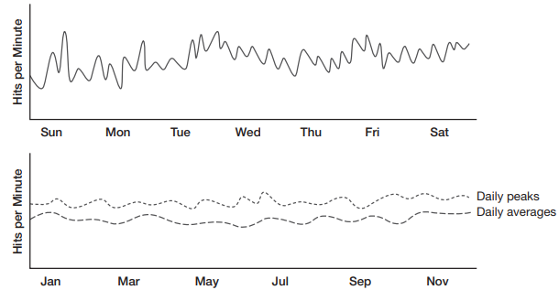
Determining the Expected Demand
To determine the expected demand for resources of a system, capacity planners need to determine individual demands of all the applications supported by the system. Later they can aggregate those results to get idea about traffic pattern of the whole system. Understanding the demand pattern of application is important as the traffic pattern generally changes with time.
Sample graphs plotted from the recorded number of hits in a web application viewed over a week and a year. Such statistics may give a fair idea regarding the overall workload pattern of application. From the weekly graph it can be seen that the spikes are not always of equal demand in a single day. Sometimes it is high, sometimes low. The yearly graph provides idea about the varying demand of an application over a year. The business goal of capacity planning is to correlate these performance spikes and dips with particular events and occasions, like product launches, special campaigning or yearly festivals.

Slide 23
Analyzing Current Load
In computing, the main resources used are – processor, memory, and storage and network connectivity. Hence the major system parameters are processor speed, memory access speed, disk I/O access speed and network I/O access speed.
Loads on each of these resources can be measured by operating-system-specific tools.
Resource load affects system-level performance.
Each of the resources has a utilization rate, and when one or more of these resources reaches the maximum, that limits performance of the system. This limit is called stress point.
System architects must execute tests to see how different scenarios create stress points on the infrastructure.
The ability to understand the resource usage patterns and constraints is very important in capacity planning. It may seem that simply adding another server or resource component to the pool of resources can fix the problem.
Resource utilization curve provides simple representation of resource utilization under load. To identify the stress point of the resources it is necessary to create all the resource utilization curves for a system

Slide 24
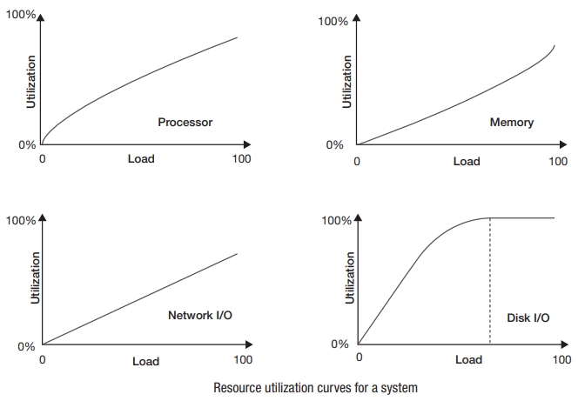
Analyzing Current Load
It is the goal of a capacity planner to identify the critical resource that has resource ceiling, and resolve the problem to move the bottleneck to higher levels of demand.

Slide 25
Value of System Capacity
Every application adds some value to the business.
It is important to know how more capacity can help the business before adding any more resources to the system just because it has hit the stress point.
One should have a clear idea about the outcome of the question - “How business can be benefited by supporting the additional load?” Understanding the value of the demand on the system will help to answer the question.
Two possible actions are there depending upon answer to the above question. Either add more capacity to support demands of pick hours, or wait for the existing capacity to become available again. The first strategy enhances system performance, while the second one reduces budget. Any of these two strategies is adoptable, depending on which one adds more value to the system.
The decision regarding capacity enhancement depends on, how much it is going to cost to add capacity against the value of that additional capacity to the business.

Slide 26
SUMMARY
Capacity planning means building a strategy that ensures the supply of adequate resources during peak demand, but at the same time reduces procurement of extra amount of resources which might have to remain idle for most of the time, in order to minimize cost.
Capacity planning is necessary for obtaining optimal system performance at minimum cost.
Cloud computing has changed the perception of the traditional way of capacity planning in computing. The traditional fixed cost capacity planning with N+1 approach of capacity maintenance was not a full proof system.
The variable cost capacity maintenance approach in cloud computing eliminates the resource over-provisioning and under-provisioning problems.
Wrong capacity planning results in huge business loss in traditional computing. Cloud service consumers are also not totally relieved of the capacity planning task; but, they are at low risk if their estimation is wrong.
The cloud infrastructure service provider, after collating the service level agreements and obtaining data on resource requirements from all consumers, does the actual overall capacity planning for physical set of resources.
The delivery of infinite resource in cloud is an illusion created through proper capacity planning, by cloud service providers.
Cloud service provider analyzes capacity; estimates load and takes decisions about adding new resources in the pool as required, only if the additional capacity adds value to an application.

Slide 27
Next Lecture:
File System in Cloud Computing
Note: The lecture will be provided on Moodle a day before the Lecture.

Slide 28
References:
Cloud Computing (Text Book)
[1] Bhowmik, S. (2017). Cloud computing. Cambridge University Press.
[2] Sehgal, N. K., & Bhatt, P. C. (2018). Cloud computing. Heidelberg: Springer.
The text book provided on your Moodle account

Slide 29
Questions & Answers

Slide 30
Thank You

